Slide 1
Descriptive Statistics

Slide 2
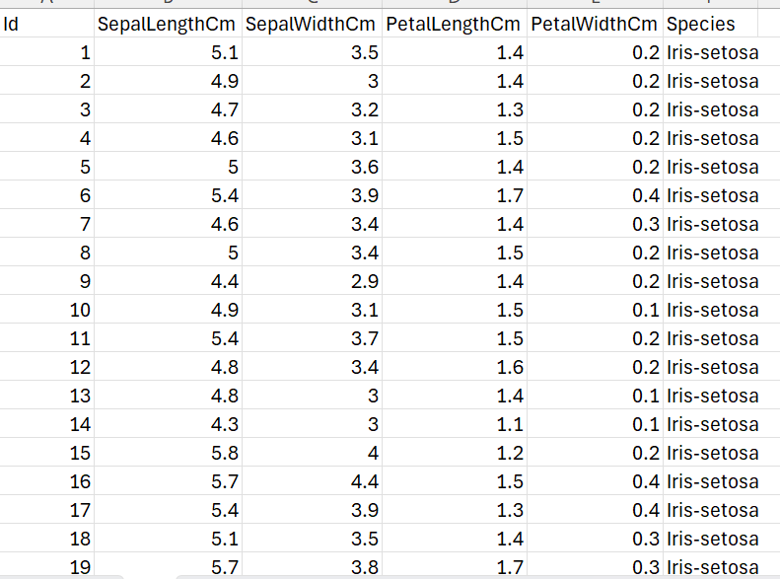
Descriptive statistics
Descriptive statistics helps to simplify large amounts of data sensibly. This section will look at measures of central tendency and measure of spread. For illustrative purposes, we’ll use variables from the Iris dataset( you can download it from this link( https://www.kaggle.com/datasets/uciml/iris )
Our focus will be on SepalLenghtCM, SepalWidthCM, PeatLengthCM, and PetalLengthCm).

Slide 3
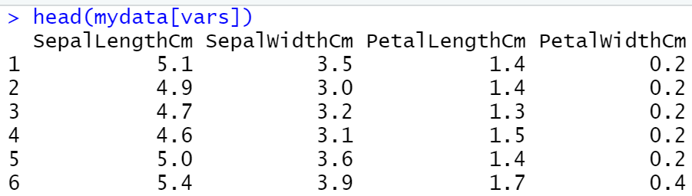
Descriptive statistics

Slide 4

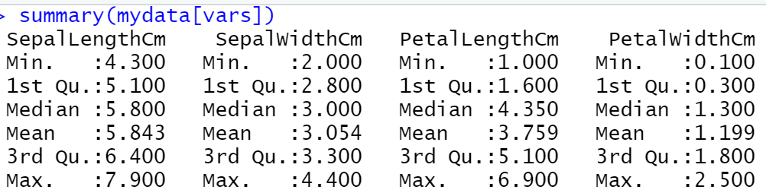
Descriptive statistics
We can use the summary() function in the base installation to obtain descriptive statistics. An example is presented in the following listing.

Slide 5
Annotating datasets
Data analysts typically annotate datasets to make the results easier to interpret. Typically annotation includes adding descriptive labels to variable names and value labels to the codes used for categorical variables. For example, for the variable age, you might want to attach the more descriptive label “Age at hospitalization (in years).” For the variable gender coded 1 or 2, you might want to associate the labels “male” and “female.”
Variable labels : names(mydata)[2] <- "new“

Slide 6
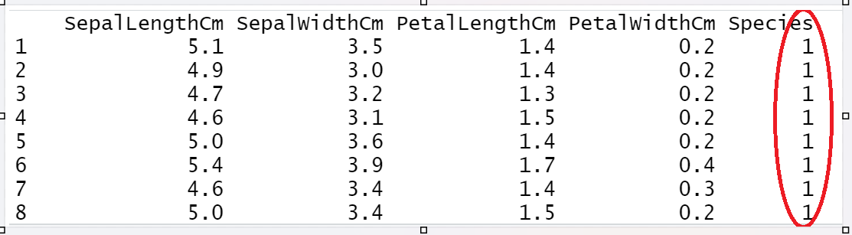
Annotating datasets
Value labels : The factor() function can be used to create value labels for categorical variables. Continuing our example, say that you have a variable named gender, which is coded 1 for male and 2 for female. You could create value labels with the code .
mydata$Species <- factor(mydata$Species,
levels = c(“Iris-setosa”, “Iris-versicolor”,“Iris-virginica”),labels = c(1,2,3))

Slide 7
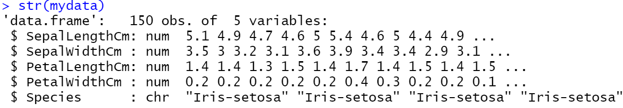
To see the summery of the structure of data set
str(mydata)

Slide 8

Finding the Standard deviation of the Attribute
s<-mydata$SepalLengthCm
sd(s)

Slide 9

Get standard deviation of multiple Attributes in R using dplyr
summarise_if() Function along with is.numeric is used to get the standard deviation of the multiple column.
library(dplyr)
mydata %>% summarise_if(is.numeric, sd)

Slide 10
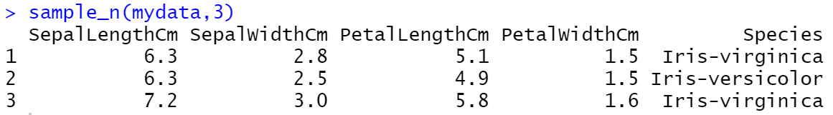
Selecting Random N Rows using dplyr
sample_n(mydata,3)

Slide 11
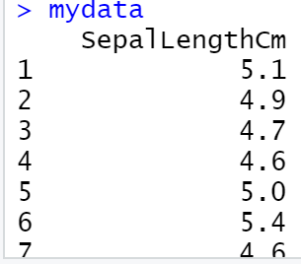
Selecting specific Variables
mydata2 = select(mydata, SepalLengthCm )

Slide 12
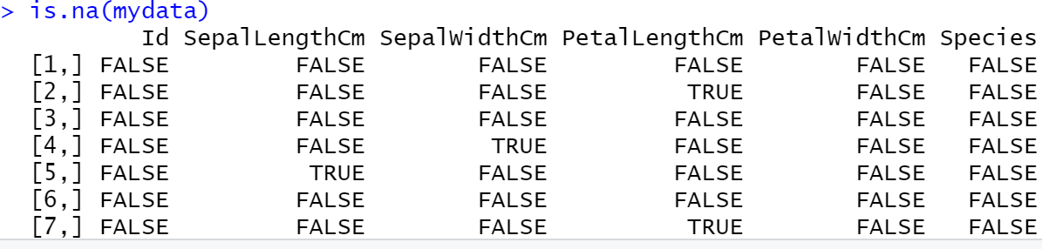
Detecting Null values for Iris Data set.
mydata<- read.csv("D:/Iris.csv",header = TRUE,sep = ",")
mydata
is.na(mydata)

Slide 13
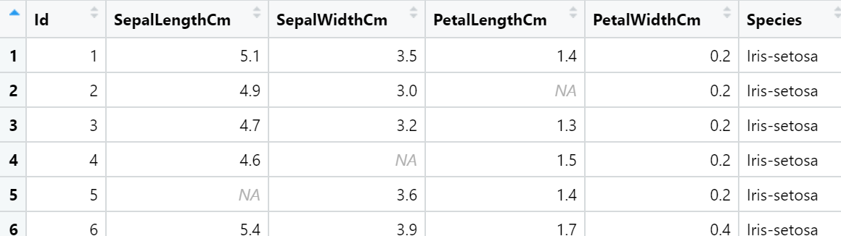
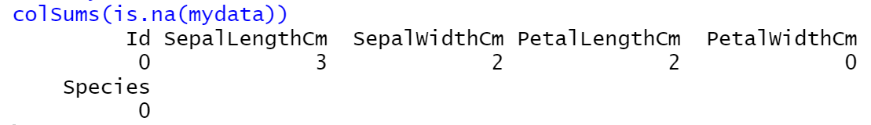
Counting number of Null values in each column
mydata<- read.csv("D:/data.csv",header = TRUE,sep = ",")
mydata
colSums(is.na(mydata))

Slide 14

Finding the specific row number of Null values.
which(is.na(mydata$SepalLengthCm))

Slide 15
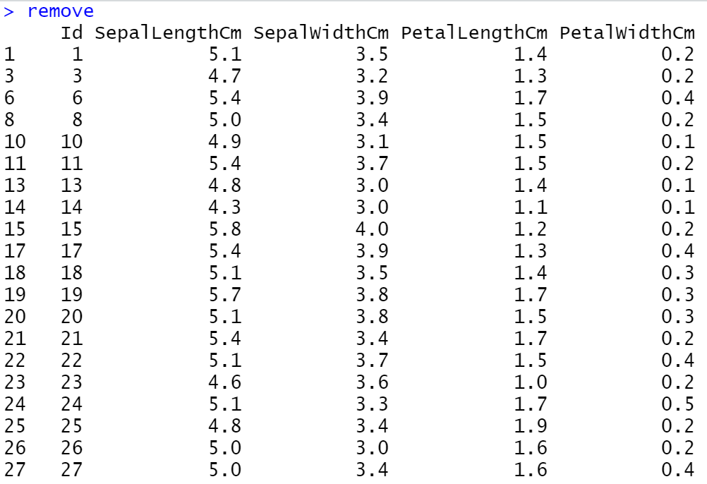
Remove null values from Iris data set.
remove<- na.omit(mydata)

